Slide 1
Q: What is “optimization” broadly
A: Any problem that has the following “ingredients”:
A goal to (best!) achieve → this is the “objective”
Some choices to be made towards that goal → these are the “control variables”
Some restrictions on the possible choices → these are the “constraints”
Key: Identifying these 3 correctly is often half the task!

Slide 2
Optimization everywhere (life examples)
Can be formulated as optimization problems:
Nutrition (what to eat every day/week)
Objective: maximize happiness (or maximize health)
Control variables: how much of each (meat, veggies, fruit, etc.)
Constraint(s): total cost per day/week
Investment
Objective: maximize (expected?) wealth after X years
Control variables: amount to invest in different items (stocks, real estate, savings, etc.)
Constraint: total amount of money I have
Packing a bag for a trip
Objective: maximize the usefulness of clothes packed
Control variables: whether to take an item or not (binary)
Constraint: Size and max weight of bag

Slide 3
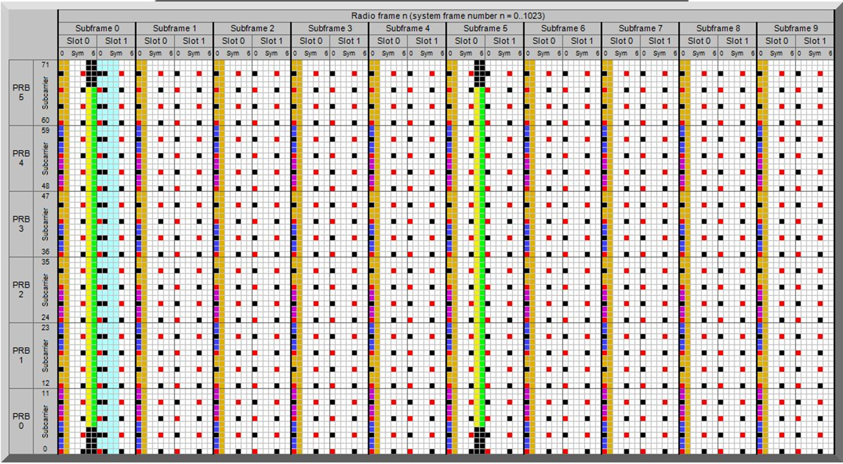
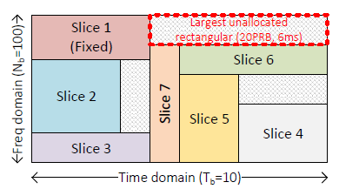
Optimization everywhere (technical examples)
Cellular systems (4G, 5G,…)
(MAC) scheduling: assign resource blocks to users
Slicing: assign (larger) resource blocks to services/tenants
frequency
time
objective: spectral efficiency? fairness?
control variables: which user where
constraint(s): total resource blocks; perf. guarantees to (some) users
similar: replace “user” with “service/tenant”

Slide 4
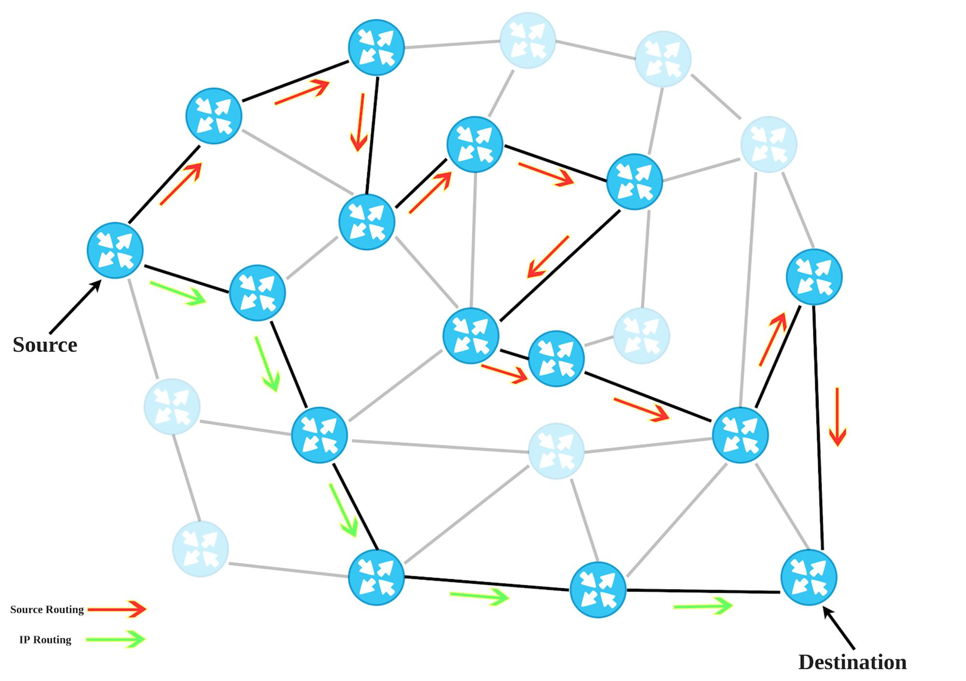
Optimization everywhere (Routing)
objective: min delay, variables: path, contraint: link capacity

Slide 5
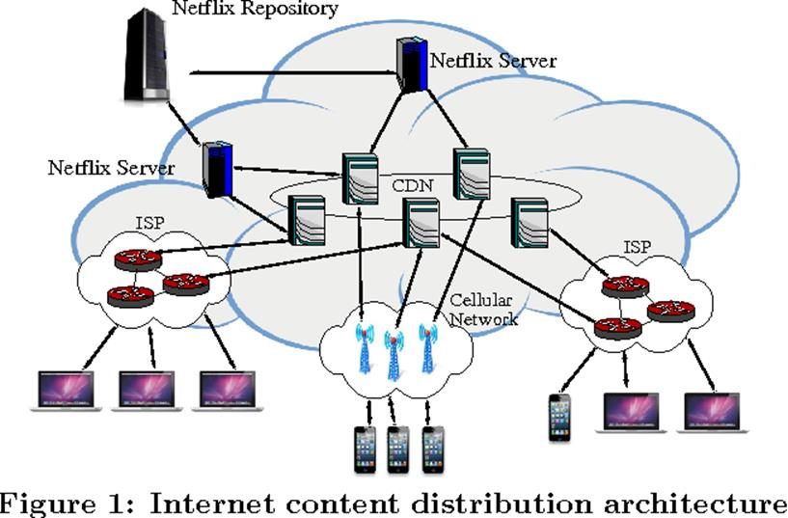
Optimization everywhere (Content Distribution Networks -CDN)
objective: minimize distance to requested (Netflix) content
variables: which content to place where
constraint: cache capacity

Slide 6
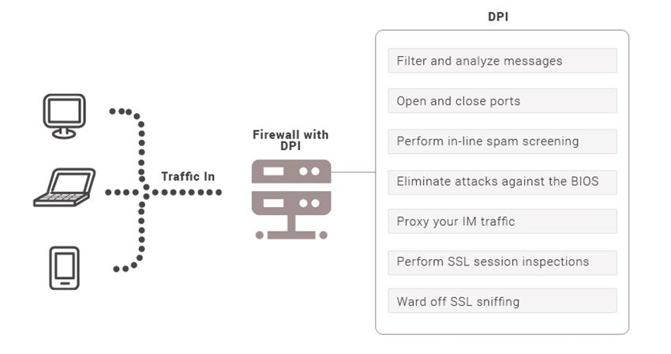
Optimization everywhere (Security – Deep Packet Inspection)
obj: max. probability to detect intruder, malicious traffic
variables: on which packets to perform DPI
constraints: capacity/speed of DPI box (e.g., 1000 pkt/sec)

Slide 7
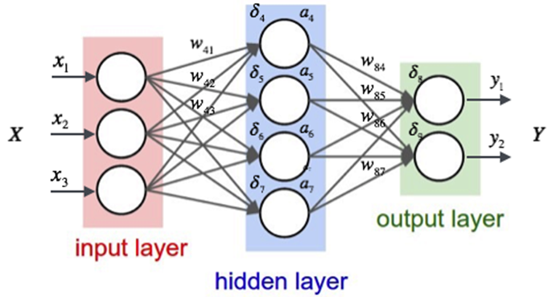
Machine Learning
All ML algorithms solve some optimization problem
Regression, SVM, Clustering, Lasso, Recommendations (Matrix Completion), …
objective: minimize (image) classification error
variables: neural network weights
constraint: number of non-zero weights (usually “regularizer”)
Key: Machine Learning is Optimization (Training) and Statistics (Generalization)

Slide 8
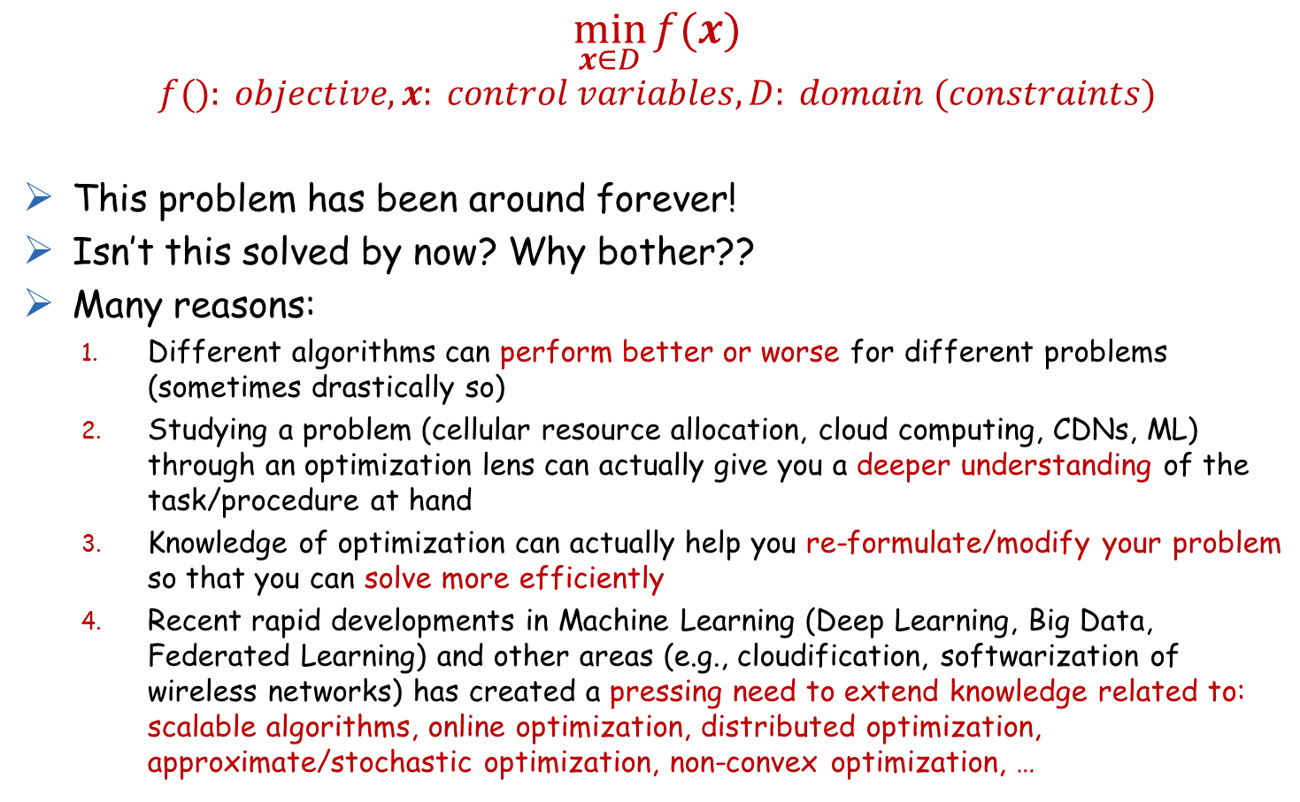
A Good Time to (Re-)learn Optimization
$$\min_{x∈D}{f(x)}$$
$$f(): objective, x: control variables, D: domain (constraints)$$
This problem has been around forever!
Isn’t this solved by now? Why bother??
Many reasons:
Different algorithms can perform better or worse for different problems (sometimes drastically so)
Studying a problem (cellular resource allocation, cloud computing, CDNs, ML) through an optimization lens can actually give you a deeper understanding of the task/procedure at hand
Knowledge of optimization can actually help you re-formulate/modify your problem so that you can solve more efficiently
Recent rapid developments in Machine Learning (Deep Learning, Big Data, Federated Learning) and other areas (e.g., cloudification, softwarization of wireless networks) has created a pressing need to extend knowledge related to: scalable algorithms, online optimization, distributed optimization, approximate/stochastic optimization, non-convex optimization, …

Slide 9
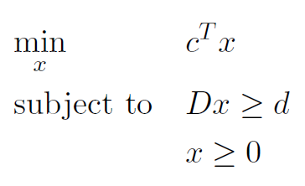
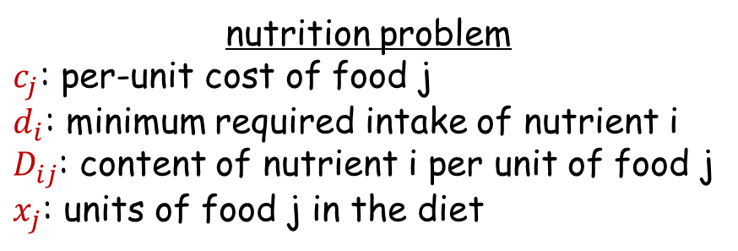
Linear Optimization Problems (LPs)
First introduced by Kantorovich in the late 1930s and Dantzig in the 1940s
Dantzig's simplex algorithm gives a direct (noniterative) solver for LPs (later in the course we'll see interior point methods)
What if variables x_{j} are integer/binary (e.g., bag packing problem) → ILP (integer linear program) → (NP) hard

Slide 10
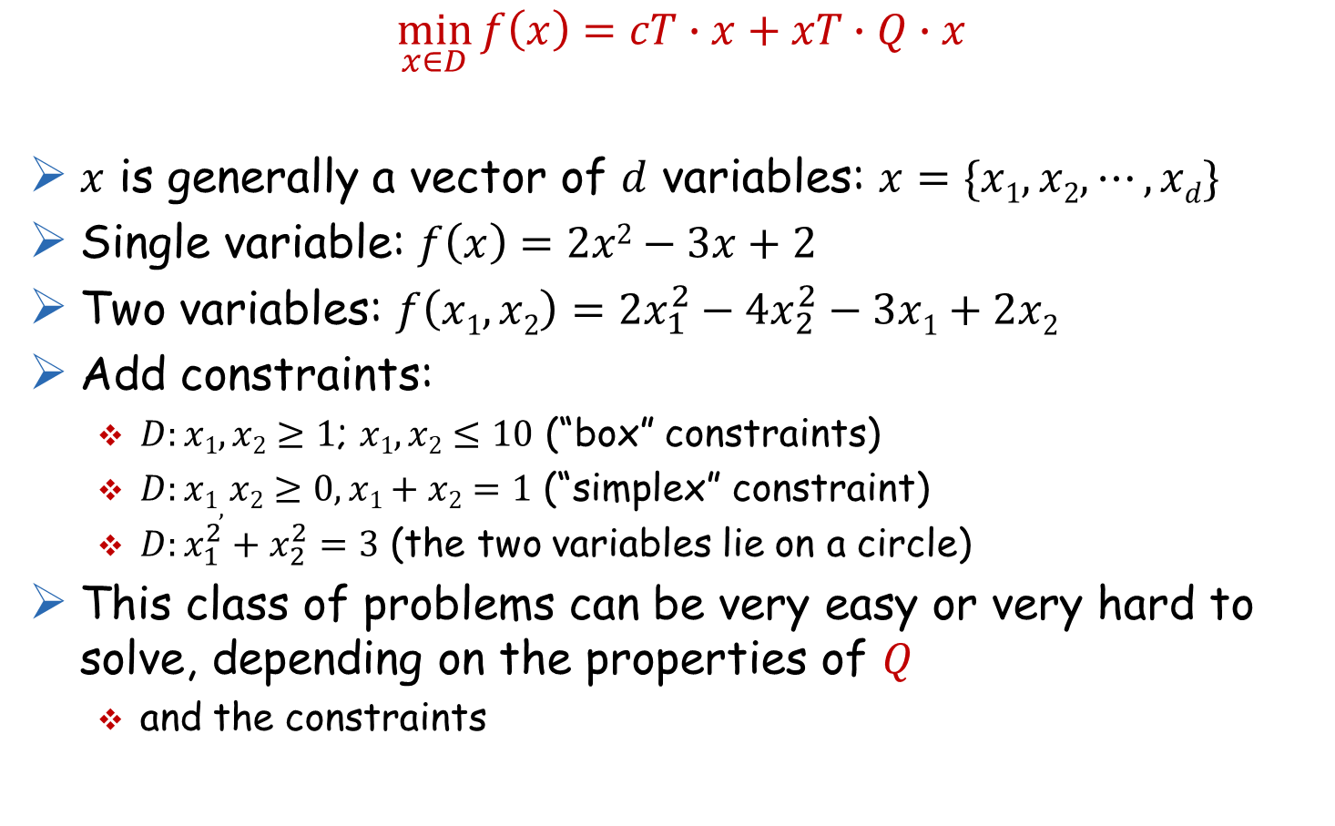
Quadratic Optimization Problem (“QP”)
$$\min_{x∈D}{f\left(x\right)=cT∙x+xT∙Q∙x}$$
$x$ is generally a vector of $d$ variables: $x=\{x1,x2,⋯,xd\}$
Single variable: $f\left(x\right)=2x2−3x+2$
Two variables: $f\left(x1,x2\right)=2x_{1}^{2}−4x_{2}^{2}−3x1+2x2$
Add constraints:
$D:x1,x2≥1$; $x1,x2≤10$ (“box” constraints)
$D:x1,x2≥0, x1+x2=1$ (“simplex” constraint)
$D:x_{1}^{2}+x_{2}^{2}=3$ (the two variables lie on a circle)
This class of problems can be very easy or very hard to solve, depending on the properties of $Q$
and the constraints

Slide 11
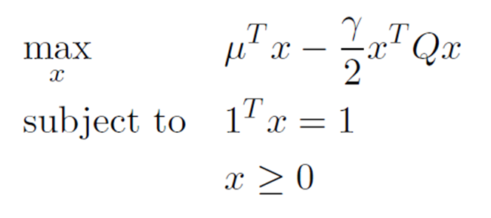
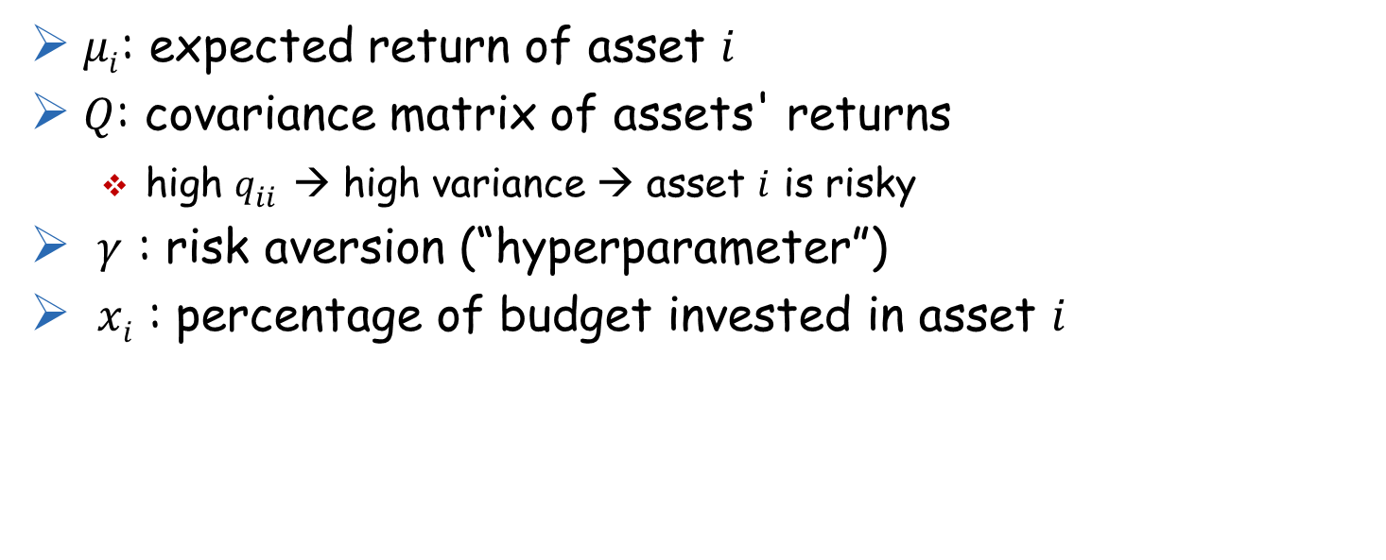
Portfolio Optimization (Quadratic Program)

Slide 12
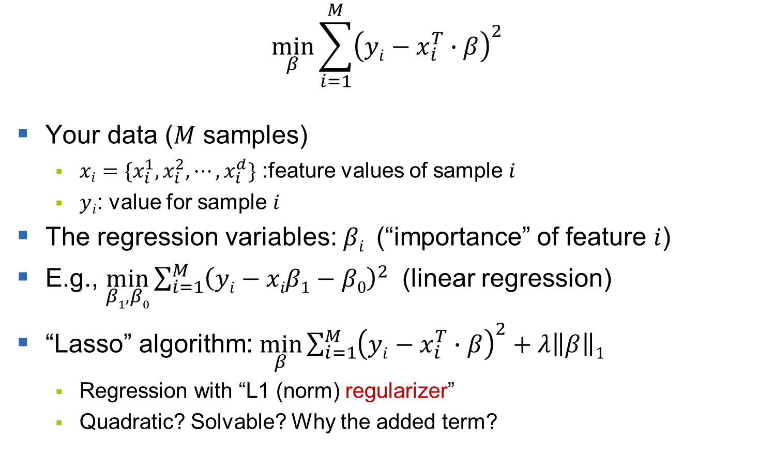
Regression (Quadratic Program)
$$\min_{β}{\sum_{i=1}^{M}{{\left(yi−x_{i}^{T}∙β\right)}^{2}}}$$
Your data ($M$ samples)
$xi=\{x_{i}^{1},x_{i}^{2},⋯,x_{i}^{d}\}$ :feature values of sample $i$
$yi$: value for sample $i$
The regression variables: $βi$ (“importance” of feature $i$)
E.g., $\min_{β1,β0}{\sum_{i=1}^{M}{{\left(yi−xiβ1−β0\right)}^{2}}}$ (linear regression)
“Lasso” algorithm: $\min_{β}{\sum_{i=1}^{M}{{\left(yi−x_{i}^{T}∙β\right)}^{2}}}+λ\left\|β\right\|1$
Regression with “L1 (norm) regularizer”
Quadratic? Solvable? Why the added term?

Slide 13
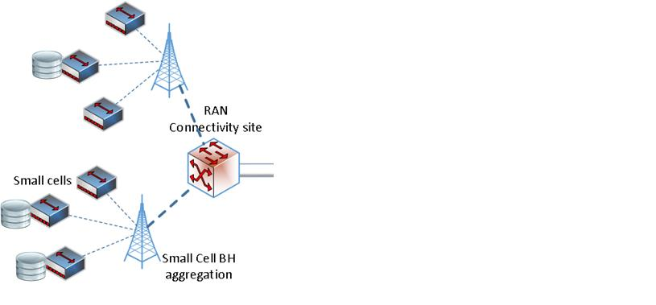

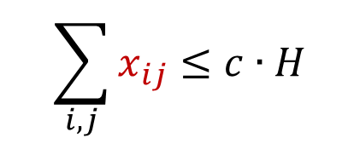
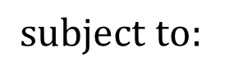
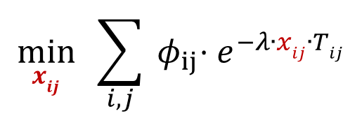
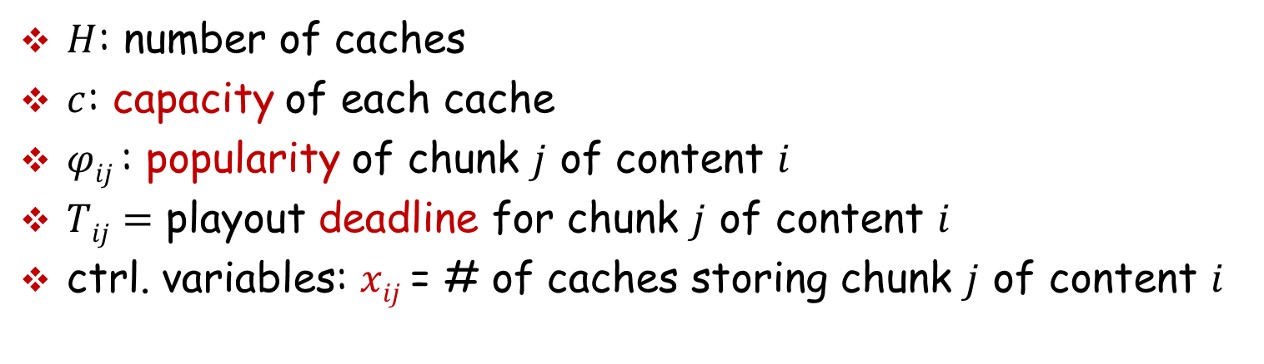
Optimal caching of chunks for pre-fetched video streaming
cache
$$\min_{xij} \sum_{i,j}{{ φ}_{ij}⋅e^{−λ∙xij∙Tij}}$$
user
$$\sum_{i,j}{x_{ij}}≤c∙H$$
$$subject to:$$
cache
cache
$H$: number of caches
$c$: capacity of each cache
$φij$: popularity of chunk $j$ of content $i$
$Tij=$ playout deadline for chunk $j$ of content $i$
ctrl. variables: $xij$ = # of caches storing chunk $j$ of content $i$

Slide 14
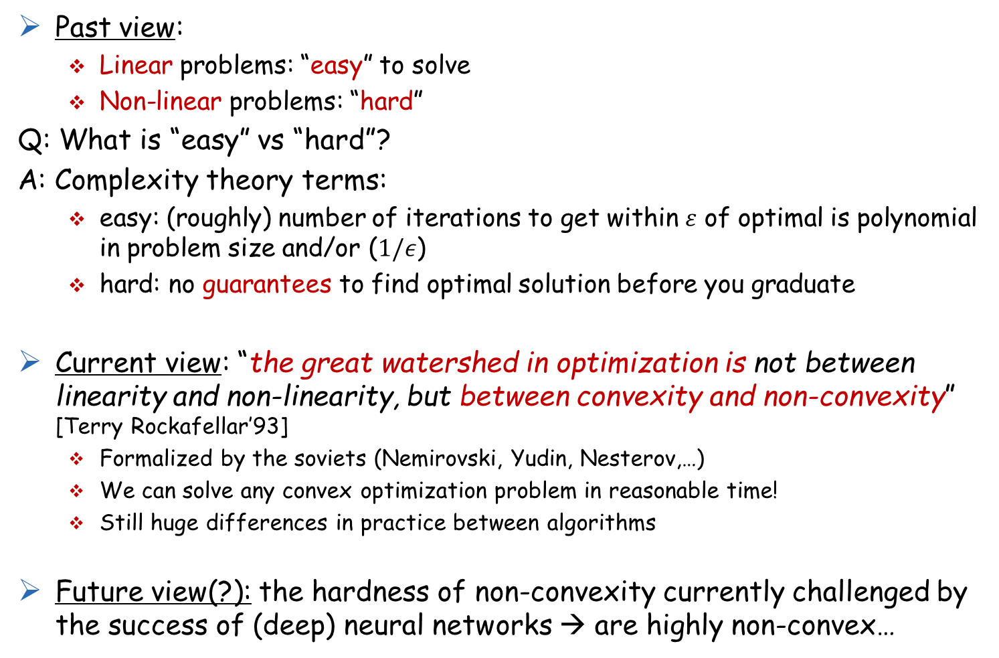
Convex Optimization
Past view:
Linear problems: “easy” to solve
Non-linear problems: “hard”
Q: What is “easy” vs “hard”?
A: Complexity theory terms:
easy: (roughly) number of iterations to get within $ε$ of optimal is polynomial in problem size and/or ($1/ε$)
hard: no guarantees to find optimal solution before you graduate
Current view: “the great watershed in optimization is not between linearity and non-linearity, but between convexity and non-convexity” [Terry Rockafellar’93]
Formalized by the soviets (Nemirovski, Yudin, Nesterov,…)
We can solve any convex optimization problem in reasonable time!
Still huge differences in practice between algorithms
Future view(?): the hardness of non-convexity currently challenged by the success of (deep) neural networks → are highly non-convex…

Slide 15
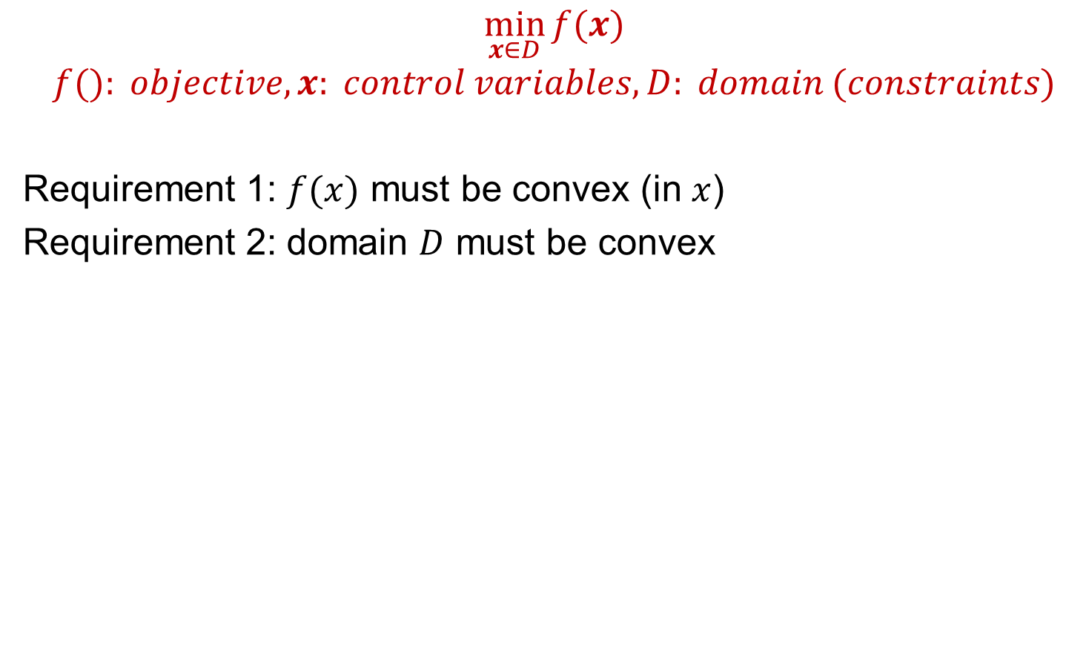
What makes a problem “convex” though?
$$\min_{x∈D}{f(x)}$$
$$f(): objective, x: control variables, D: domain (constraints)$$
Requirement 1: $f(x)$ must be convex (in $x$)
Requirement 2: domain $D$ must be convex

